Slide 2
“VAIN” 102 KJV 68 NKJV
“futile,” “worthless,” “empty,” “base,” “futility,” “frivolity,” “useless,” “foolish,” and “aimless.”
Μᾴτην “empty...(literally) profitless,...to render (passively, become) foolish, i.e. (morally) wicked or (specifically) idolatrous...folly, i.e. (adverbially) to no purpose:”

Slide 3
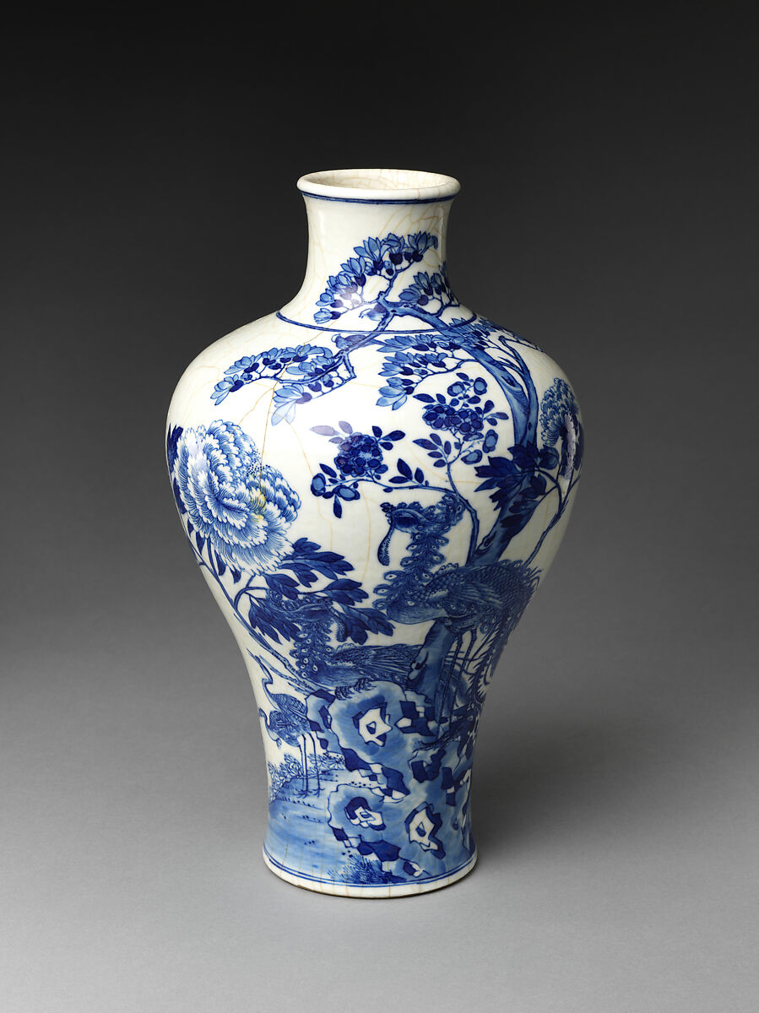
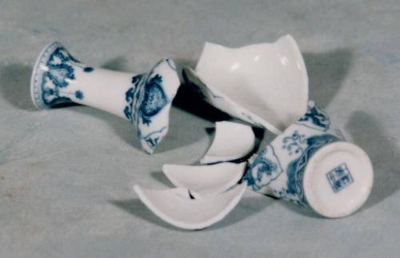
SOME things VALUABLE can become WORTHLESS if they are NOT TREATED PEOPERLY!
Valuable or worthless?

Slide 4
Things of great value
CHRIST –
  SAVIOR – Matthew 1:21 “He will save His people from their sins.“
  SACRIFICE – Hebrews 10:5-10 “Behold, I have come - in the volume of the book it is written of Me - to do Your will, O God.’
  PEACEMAKER – Romans 5:1 “we have peace with God through our Lord Jesus Christ.“
  AUTHOR OF SALVATION – Hebrews 5:8,9 “the author of eternal salvation to all who obey Him,"
  He is ONLY valuable to those who will ACCEPT HIM!
  To all others, He is WORTHLESS!
  Galatians 5:4 - Those who wanted to be justified APART FROM JESUS, were CUT OFF FROM HIM! In fact, they were "fallen from grace."

Slide 5
Things of great value
THE BLOOD OF CHRIST –
  Matthew 26:28 “For this is My blood of the new covenant, which is shed for many for the remission of sins."
  Revelation 1:5 “ "Who loved us and washed us from our sins in His own blood."
  OUR HIGH PRIEST – Hebrews 9:11,12 “He entered the Most Holy Place once for all, having obtained eternal redemption."
  His blood is ONLY VALUABLE to those who APPLY IT IN OBEDIENCE!
  To all others, it is WORTHLESS!

Slide 6
Things of great value
THE CHURCH –
  Acts 2:47 “And the Lord added to the church daily those who were being saved.”
  Acts 20:28 “shepherd the church of God which He purchased with His own blood.”
  Ephesians 3:20,21 “to Him {be} glory in the church by Christ Jesus throughout all ages”
  It is ONLY treated as VALUABLE by those who a PART OF IT, and who are LOYAL TO CHRIST!
  To all who REJECT the church it is WORTHLESS!
  Hebrews 10:29 “counted the blood of the covenant by which he was sanctified a common thing”

Slide 7
Things of great value
PREACHING –
  1 Corinthians 1:18- TWO CLASSES OF PEOPLE
    Those who think preaching is WORTHLESS!
    Those who KNOW it is the POWER OF GOD!
    Those who think it is FOOLISH are PERISHING!
    Those who accept it as the POWER OF GOD are BEING SAVED!
  Preaching is VALUABLE only to those who LOVE and OBEY the TRUTH!
  1 Corinthians 1:18-29 Those who REJECT the GOSPEL treat it as if it were WORTHLESS! Matthew 15:8,9

Slide 8
ONLY CHRIST CAN SAVE YOU!
ONLY BY HIS BLOOD!
THE SAME BLOOD WHICH PURCHASED THE CHURCH HAS MADE SALVATION POSSIBLE FOR YOU!
WHEN YOU ACKNOWLEDGE THE VALUE OF CHRIST AND HIS BLOOD
YOU WILL OBEY THE GOSPEL PREACHED
AND BE ADDED BY HIM TO HIS CHURCH!
CHRIST, HIS BLOOD, THE CHURCH, and GOSPEL PREACHING
HOW VALUABLE ARE THESE TO YOU?

